Slide 1
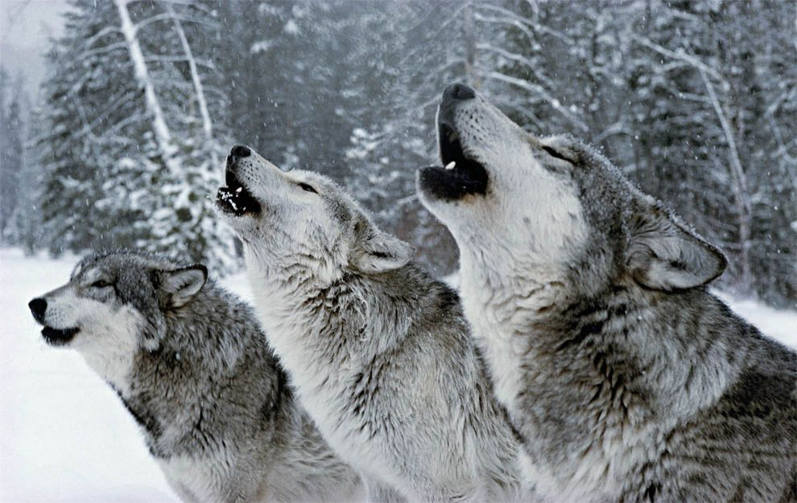
Bergström et al. (2020). Origins and Genetic Legacy of Prehistoric Dogs. Science.

Slide 2
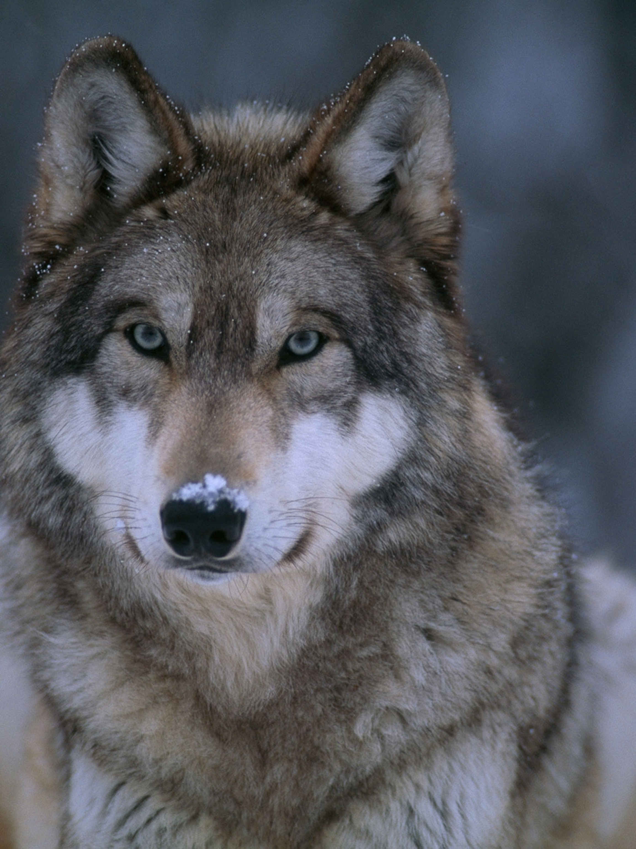
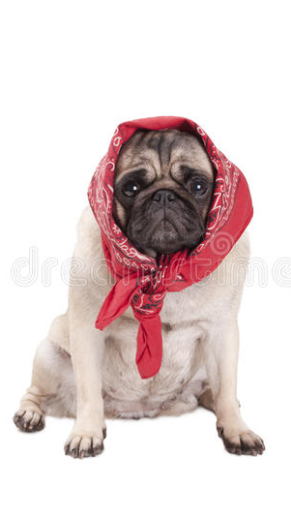
?

Slide 3
Data
27 ancient dog genomes
27 ancient dog genomes
Up to 10.9ky old
Median 1.5X coverage
Range 0.1X-11X
17 sets of human genome-wide data
Matched to the age, location, and culture of the dog samples

Slide 4
Global Population Structure of Ancient and Modern Dogs
PCA analysis (f4 statistics – similar to ABBA-BABBA)
East-West axis of dog ancestry
Western extreme:
Eurasian dogs
Modern African dogs
Eastern extreme:
Precontact North America
Siberia
East Asian
Including New Guinea singing dog and Australian dingo

Slide 5
Global Population Structure of Ancient and Modern Dogs
Ancient European dogs appear on a genetic cline between East Eurasia and ancient Near East
This cline is more consistent with a single instance of major admixture rather than tree-like or continuous gene flow.

Slide 6
Admixture graphs between major dog lineages
The oldest dog (10.9kya) received part of it’s ancestry from a lineage related to both Eastern dogs and Levantine/European dogs
This suggests that European dogs have dual ancestry – also supported by the cline

Slide 7
How many times were dogs domesticated?
Data suggests only once (wolf to dog).
Tested pairs of dogs for symmetry to gray wolves
While gene flow has occurred, it appears to have been unidirectional
From dog to wolf
Multiple domestication events would result in some dog populations sharing more ancestry with wolves.
However, all dogs were equidistant from all wolves.
This suggests after domestication, very little wolf DNA was introduced to dogs.

Slide 8
The relationship between dogs and humans
PCA results based on f4 stats from both humans and dogs matched in space and time
The population structures of both species resemble each other (P=0.043).

Slide 9
The relationship between dogs and humans
Also, admixture graphs that fit dogs were in the top 0.8-2.8% of graphs that best-explained humans
This suggests that the gene flow histories of one species can explain the gene flow history of another

Slide 10
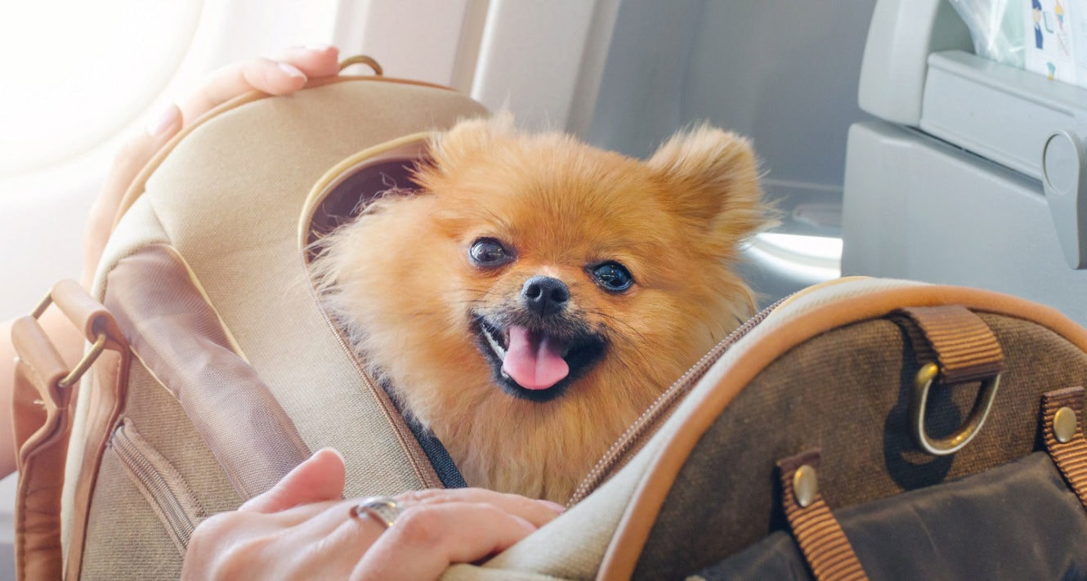
The relationship between dogs and humans
Also, admixture graphs that fit dogs were in the top 0.8-2.8% of graphs that best-explained humans
This suggests that the gene flow histories of one species can explain the gene flow history of another

Slide 11
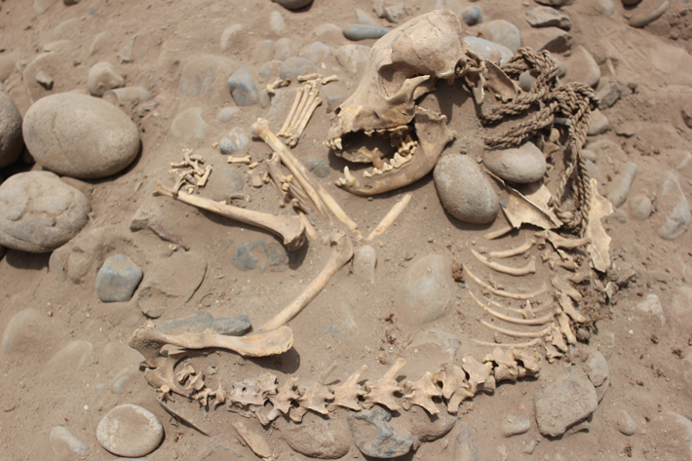
The relationship between dogs and humans
Also, admixture graphs that fit dogs were in the top 0.8-2.8% of graphs that best-explained humans
This suggests that the gene flow histories of one species can explain the gene flow history of another

Slide 12
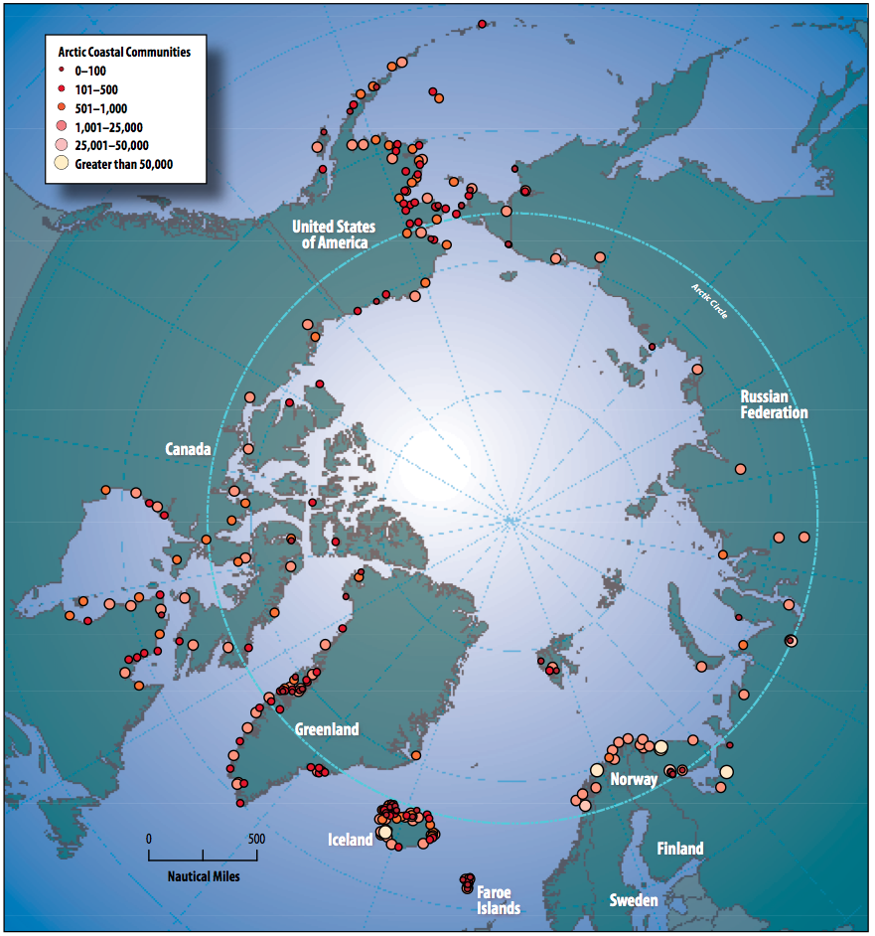
In both humans and dogs, samples from East Asia are closer to Europeans than to Near Eastern populations
This shared circumpolar ancestry is important feature of both species

Slide 13
In both humans and dogs, samples from East Asia are closer to Europeans than to Near Eastern populations
This shared circumpolar ancestry is important feature of both species

Slide 14
Expansion of a pancreatic amylase gene occurred after the transition to agriculture (~12kya).
Hunter-gatherer-associated dogs: low copy numbers
Early Neolithic dogs: variable copy numbers

Slide 19
Conclusions
At least five dog lineages were present at the onset of the Holocene (10kya)
This was followed by a dynamic population history that tracked humans in many ways
Although humans may have sometimes moved without dogs, and dogs must have moved between human groups (perhaps through trade)
Modern and ancient genomes are consistent with a single origin of dog domestication.
No insights into the geographic origin of dog domestication.

